Slide 1
NDUB Computer Club Management System
Efficient Management of Club Activities Presented by: [Tasdiqul Huq & Esha Silvia Rozario]

Slide 2
Introduction
NDUB Computer Club Management System :
A dynamic web application designed to manage the activities, members, committees, and events of the NDUB Computer Club.
Aim: To provide an efficient and user-friendly interface for club management and communication.

Slide 3
Project Overview
Key Features:
Homepage with club information and upcoming events.
Members page displaying all club members.
Committees page displaying all committees.
Events page displaying all events.
Admin page for managing club data.

Slide 4
Database Structure
Tables-
Members:
id (Primary Key)
name
email
student_id
year
Committees:
id (Primary Key)
committee_name
Events:
id (Primary Key)
event_name
date
Database Connection:
PHP script (db.inc.php) to connect to the MySQL database.

Slide 5
Front-End Development
Homepage (index.php):
Welcomes users.
Provides club information.
Lists upcoming events dynamically.
Design Elements:
Modern, clean design.
Responsive layout.
Soft grey background for better readability.

Slide 6
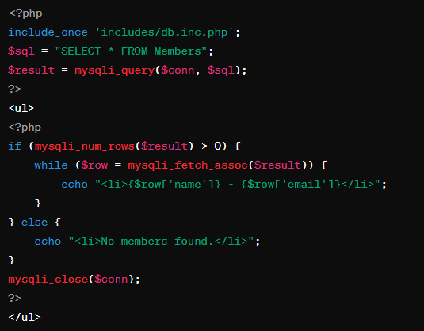
Members Page (members.php)
Features:
Lists all club members.
Data fetched dynamically from the database.

Slide 7
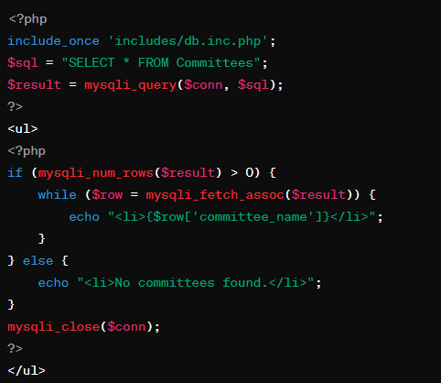
Committees Page (committees.php)
Features:
Lists all committees.
Data fetched dynamically from the database.

Slide 8
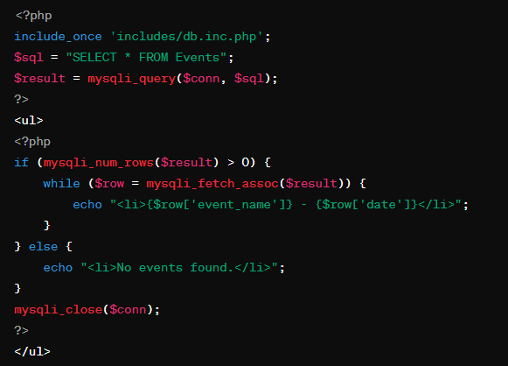
Events Page (events.php)
Features:
Lists all events.
Data fetched dynamically from the database.

Slide 9
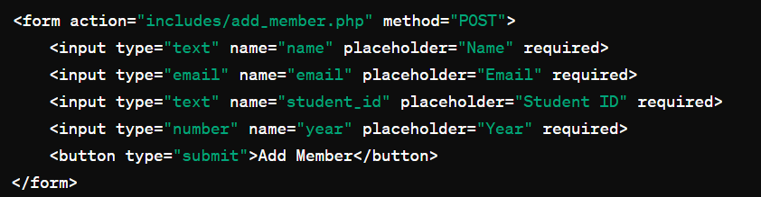
Admin Page (add_delete_entries.php)
Features:
Allows admin to add and delete members, committees, and events.
Simplifies data management.

Slide 10
Back-End Development
Database Connection:
PHP script (db.inc.php) for connecting to the MySQL database.
Data Handling:
CRUD operations for members, committees, and events.
SQL queries for inserting, deleting, and retrieving data.
Dynamic Content:
PHP scripts dynamically generate content based on database data.

Slide 11
Conclusion
Summary:
The NDUB Computer Club Management System provides a robust and user-friendly platform for managing club activities.
Dynamic web interface ensures efficient management of members, committees, and events.
Enhances communication and coordination within the club.

Slide 12
THANK YOU!

